Slide 1
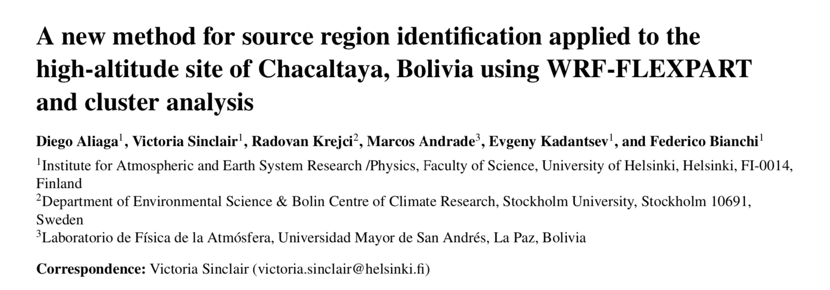

Slide 2
Overview
WRF-FLEXPART Transport Modeling during the SALTENA campaign 12-2017~5-2018
Continuation and improvement of the previous WRF-HYSPLIT study
Identification of the BL influence at CHC
Proof of concept: Identification of the anthropogenic source of BC at CHC
Proof of concept: Identification of the volcanic source of sulfate sampled at CHC
User friendly dataset: github

Slide 3
1. WRF-FLEXPART Transport Modeling during the SALTENA campaign 12-2017~5-2018
Continuation and improvement of the previous WRF-HYSPLIT study

Slide 4
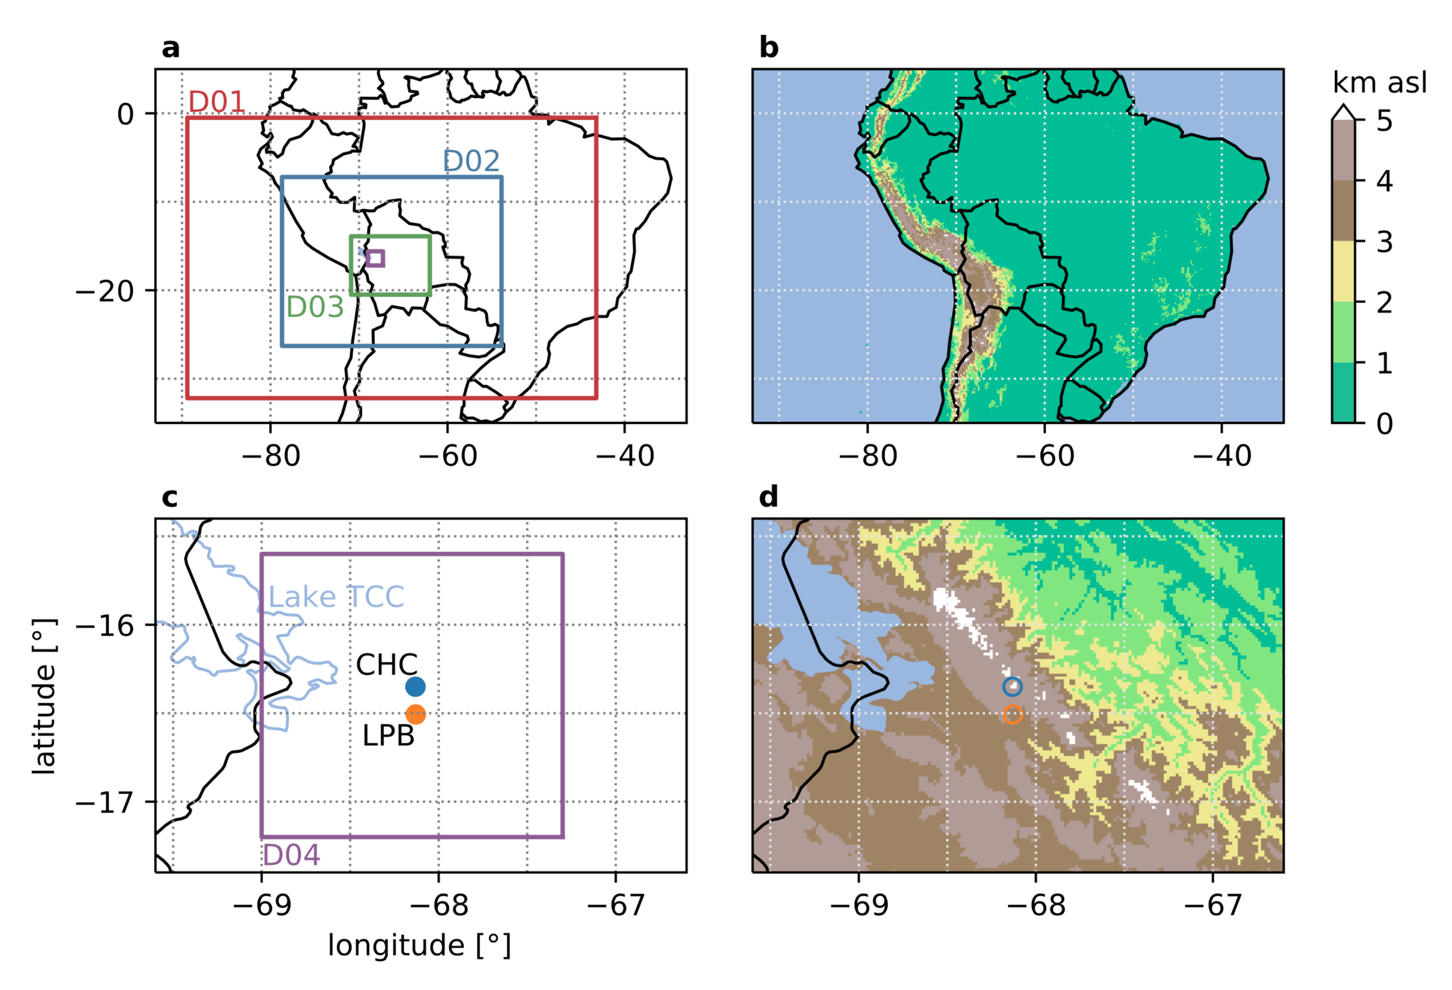

Slide 5
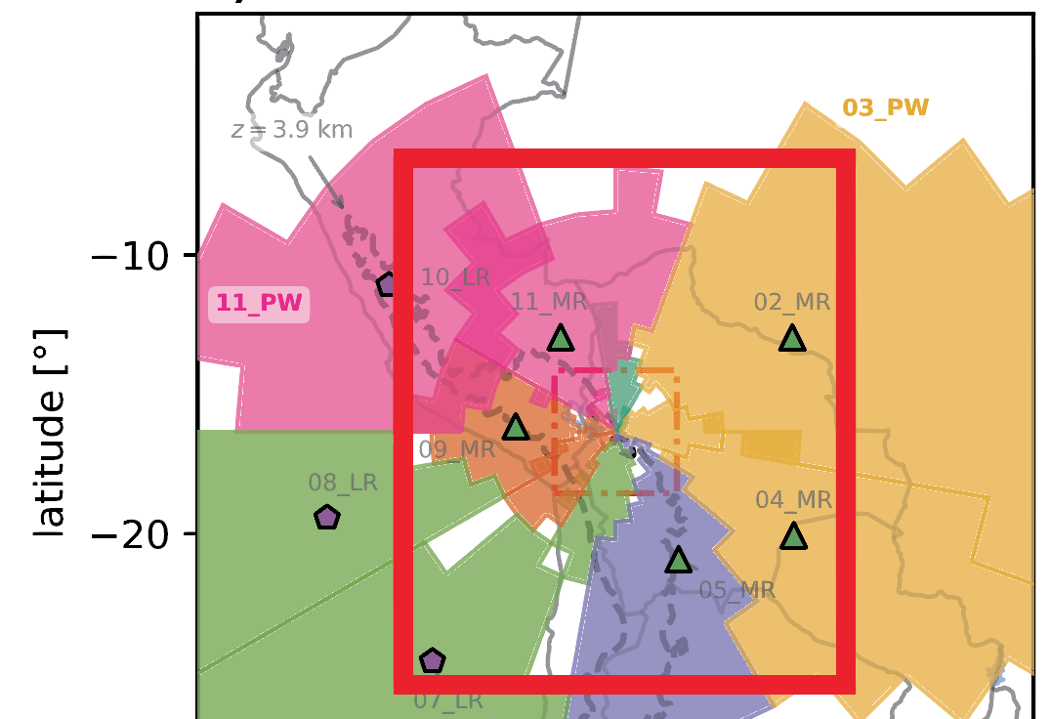
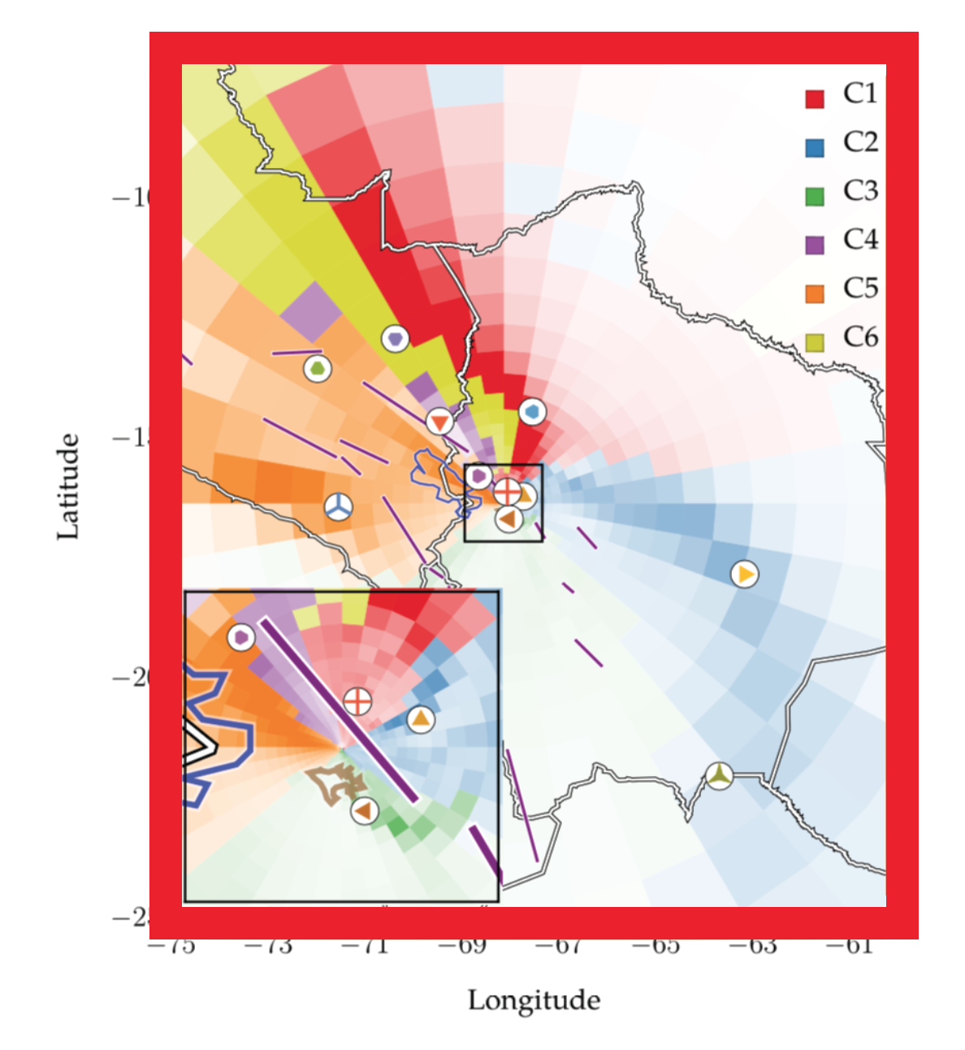
Comparisons
2012~2016
HYSPLIT (backtrajectories)
12-2017~05-2018
FLEXPART (dispersion)

Slide 6
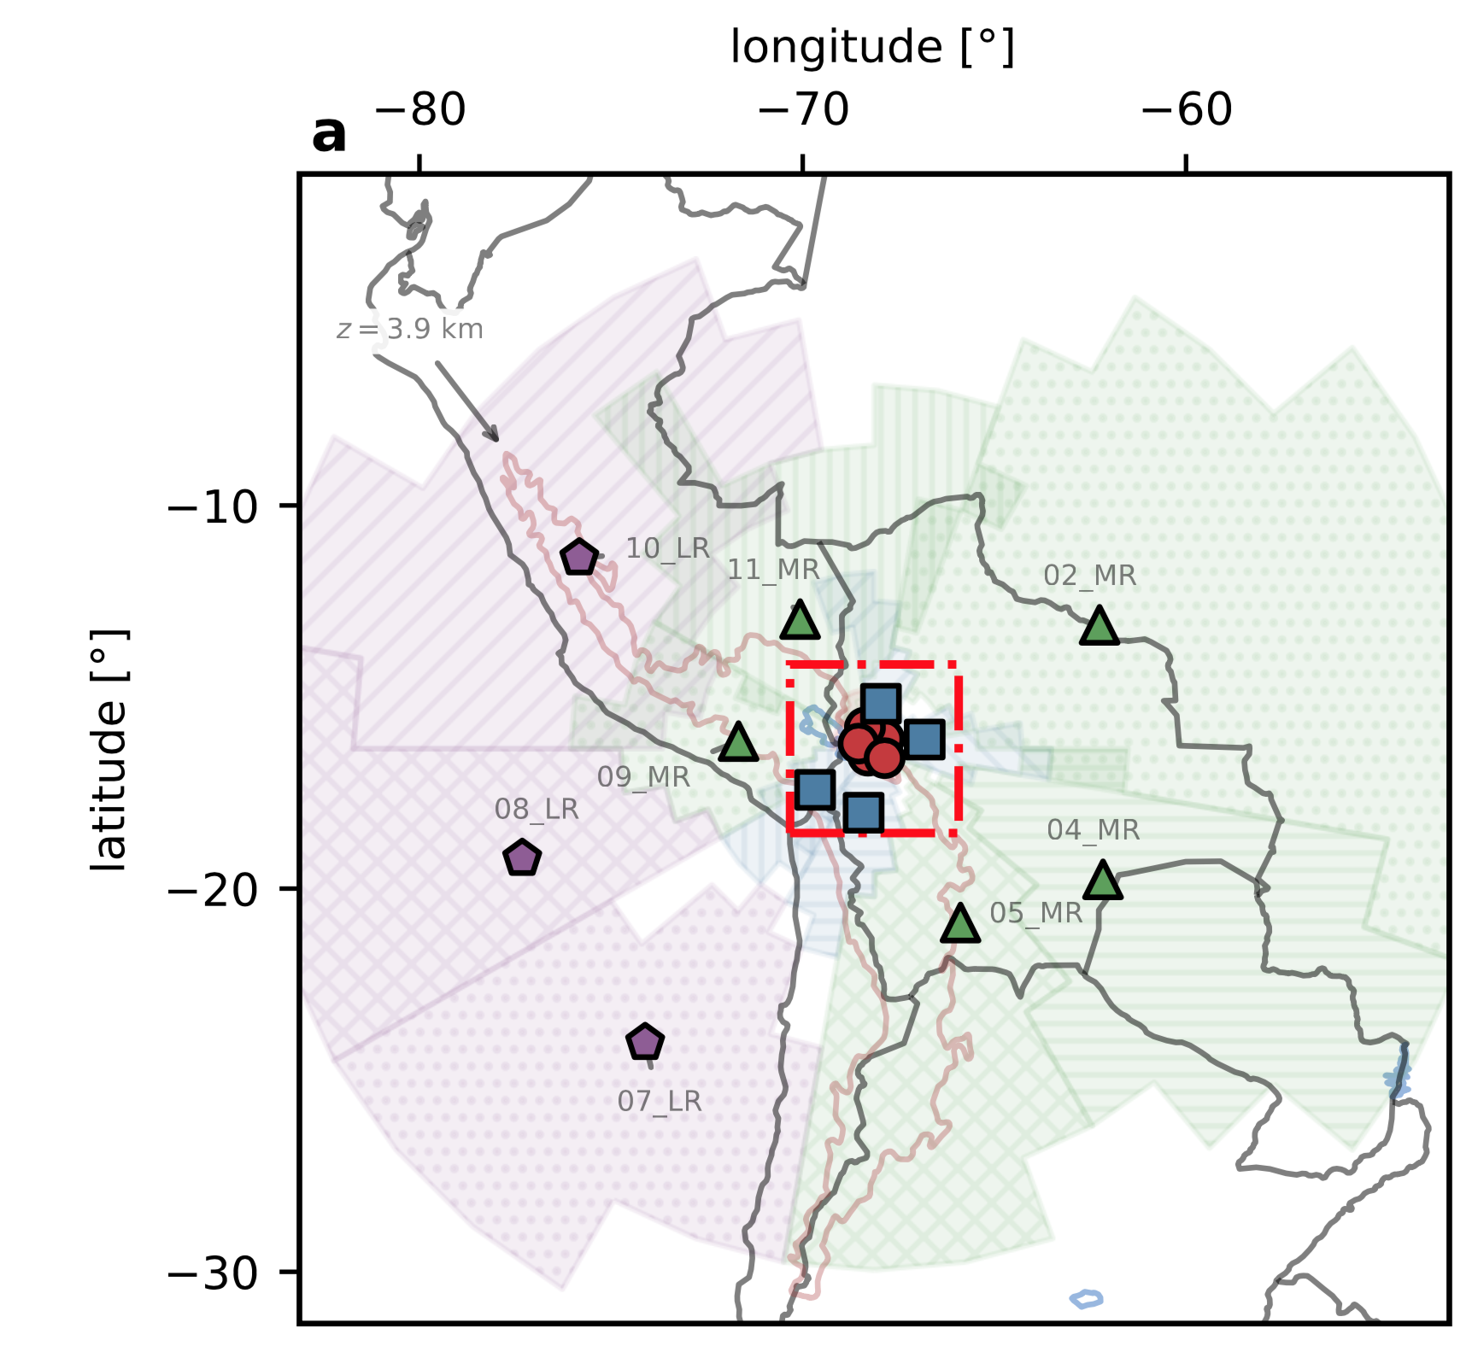
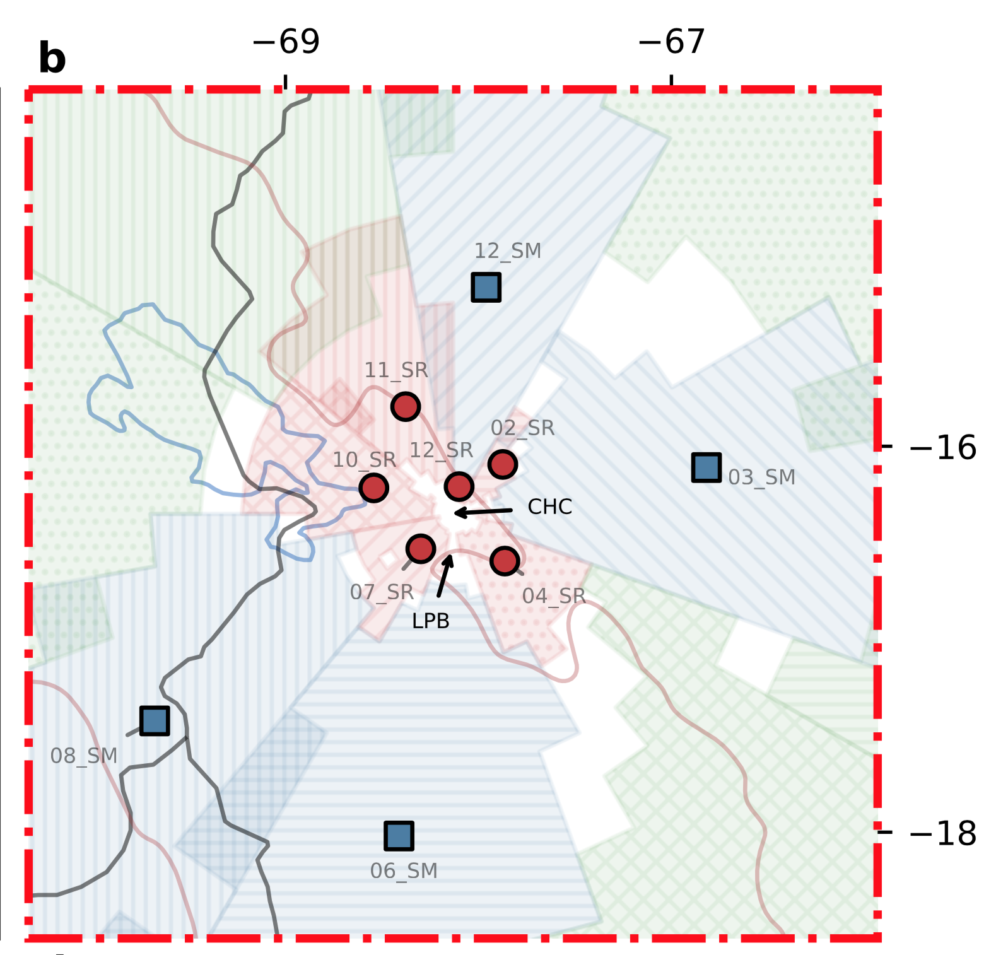

Slide 7
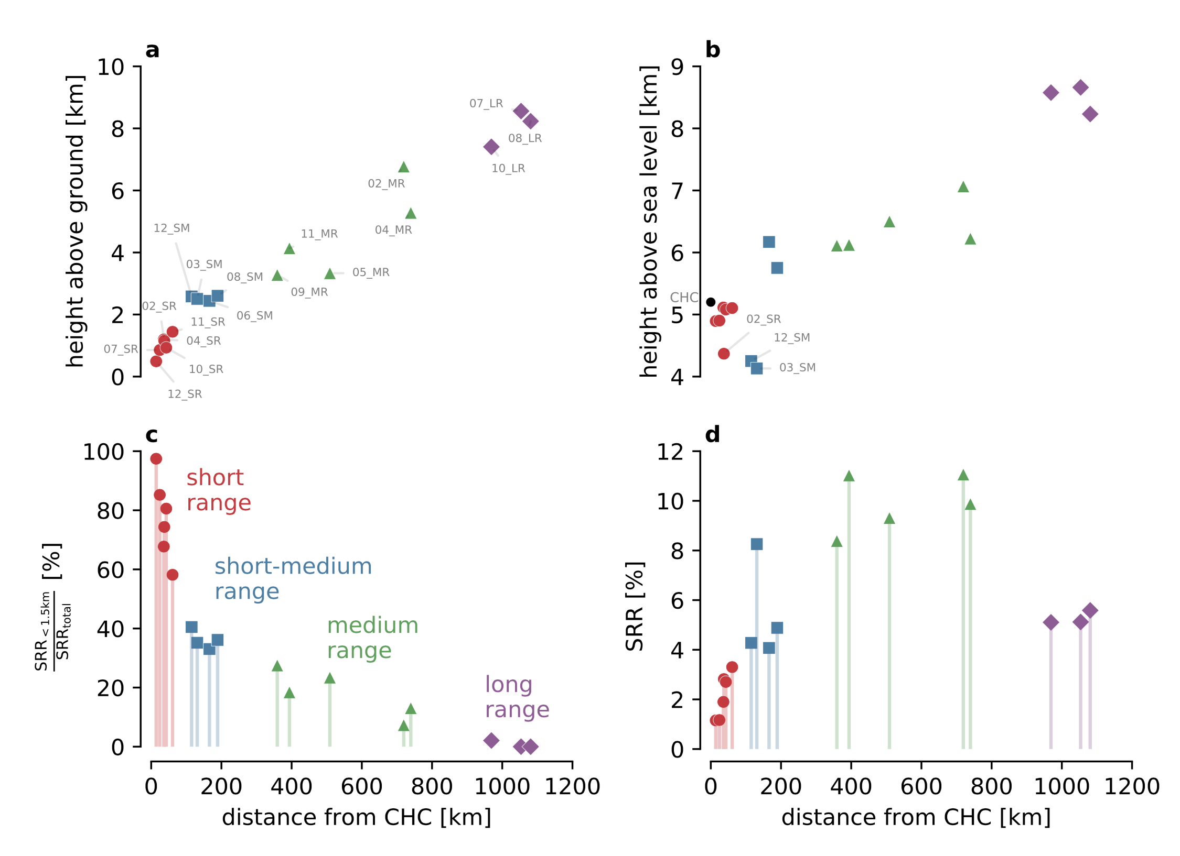

Slide 8
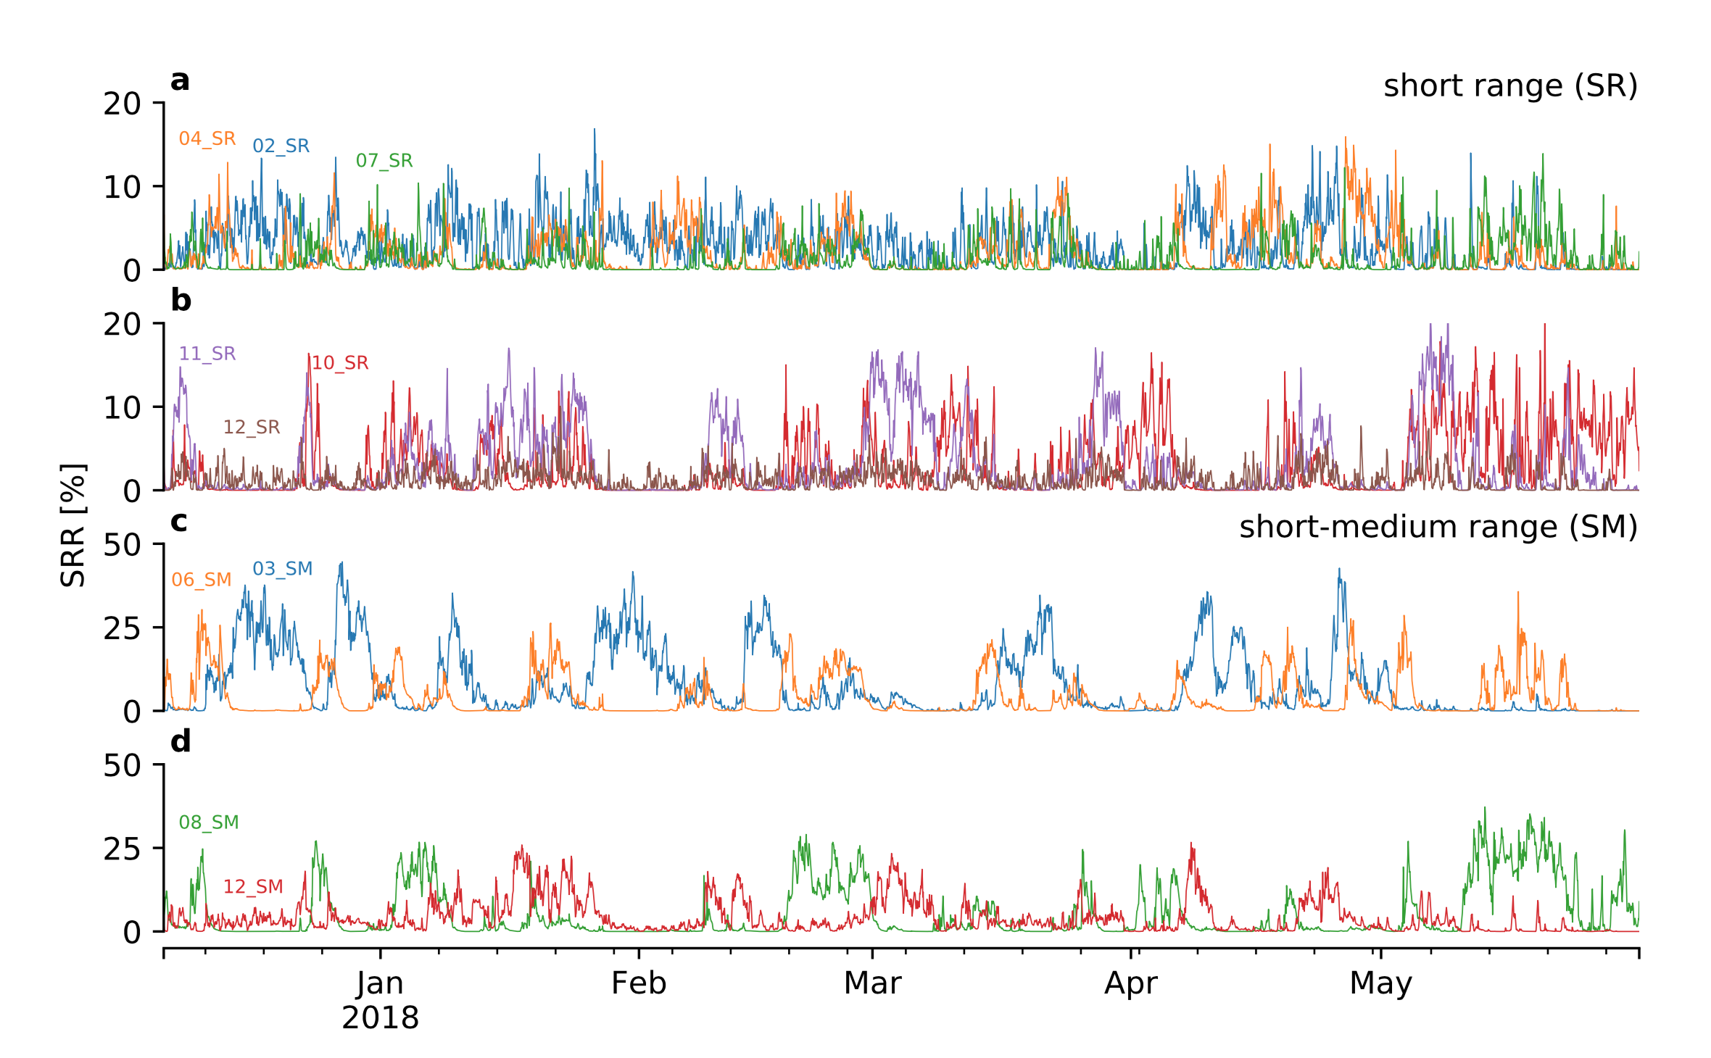
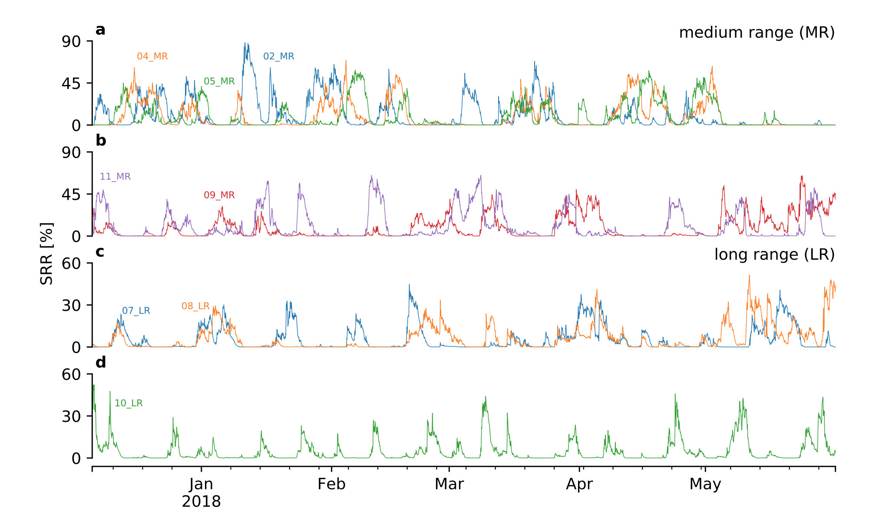

Slide 9
Identification of the BL influence at CHC

Slide 10
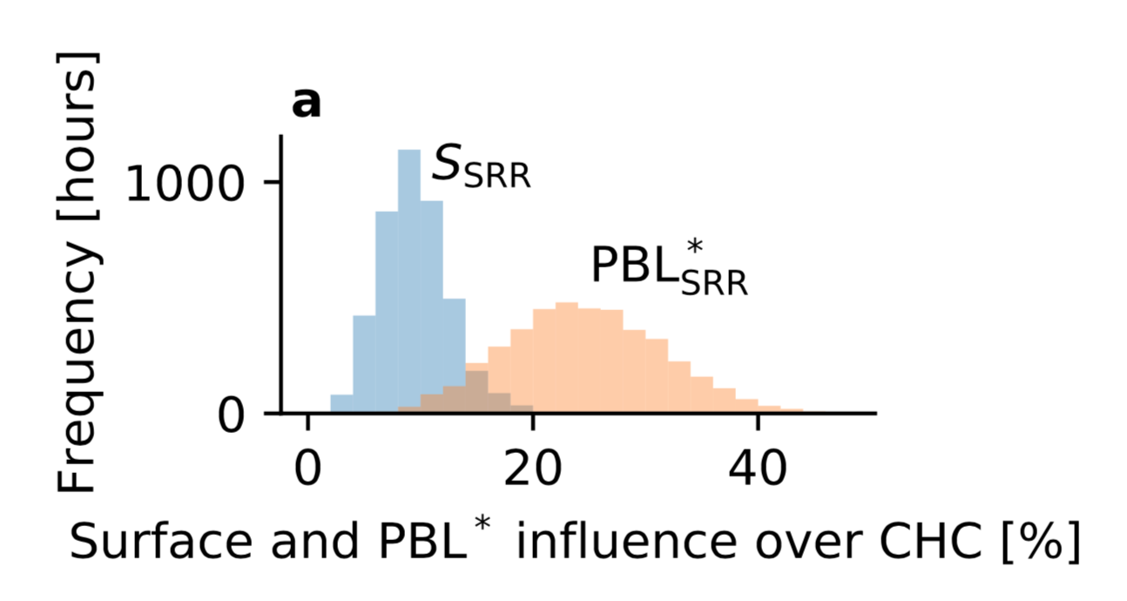
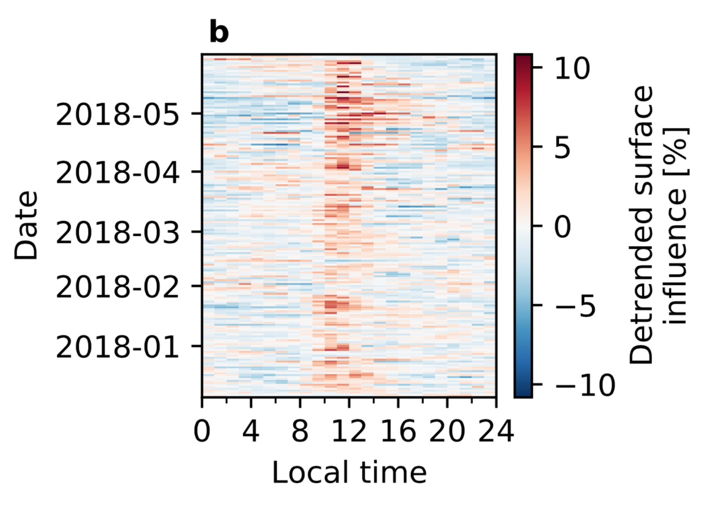

Slide 11
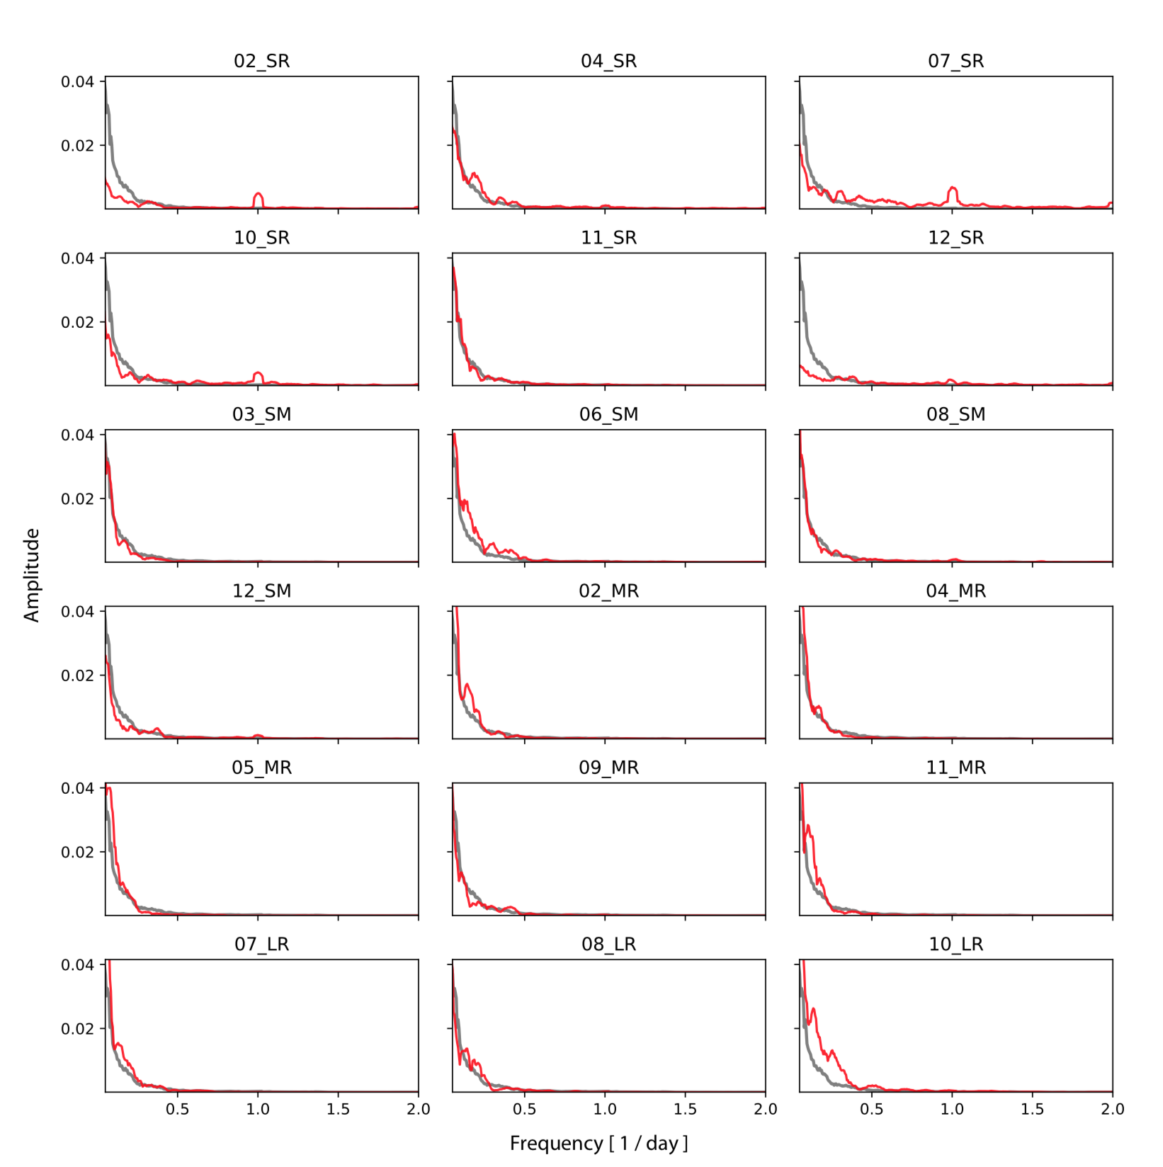

Slide 12
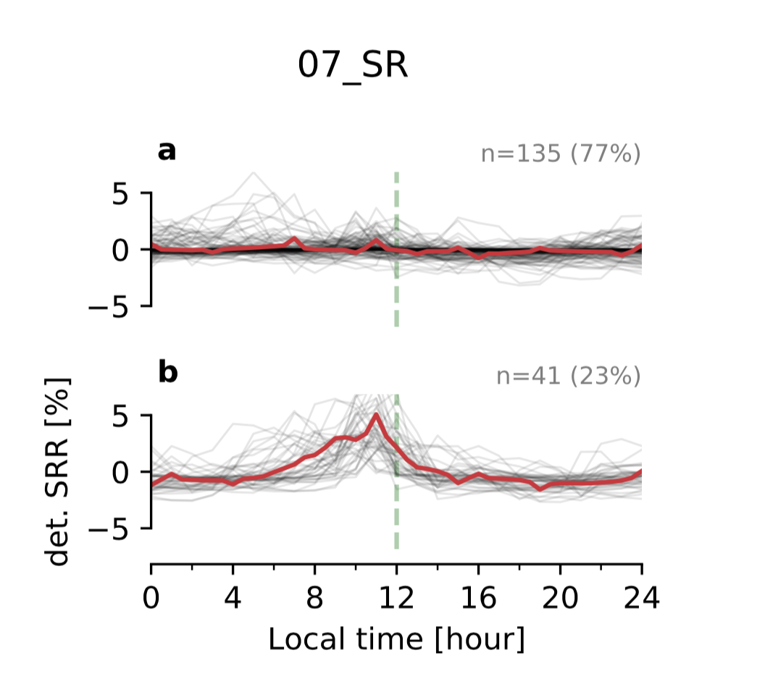
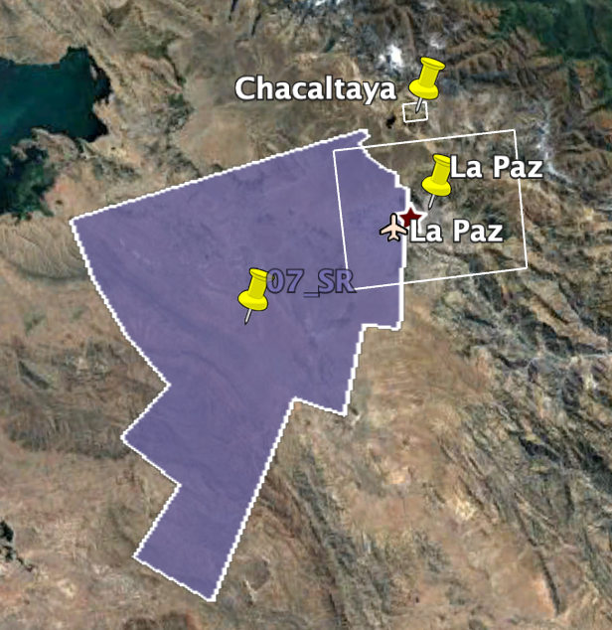

Slide 13
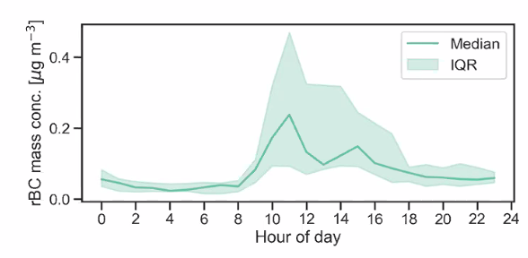

Slide 14
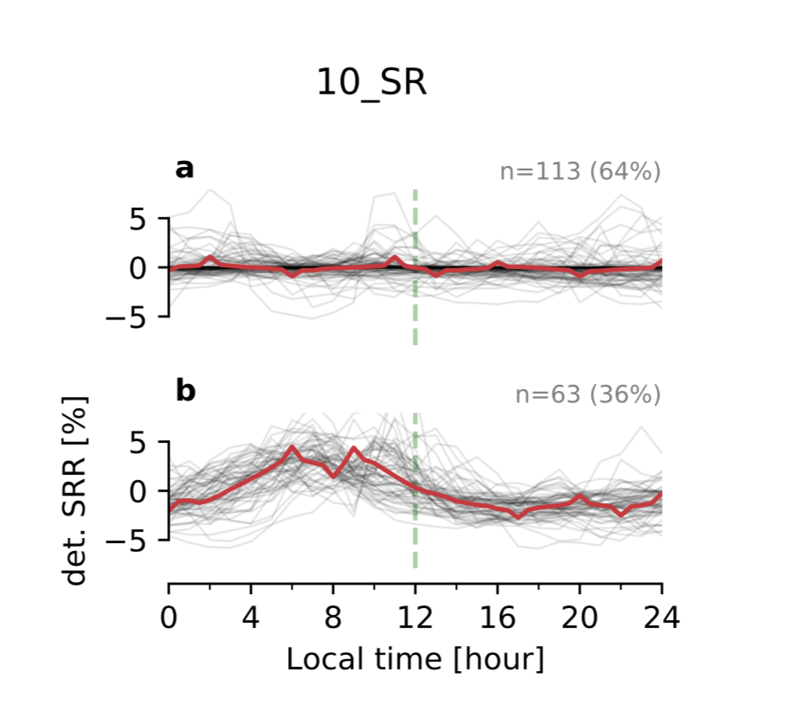
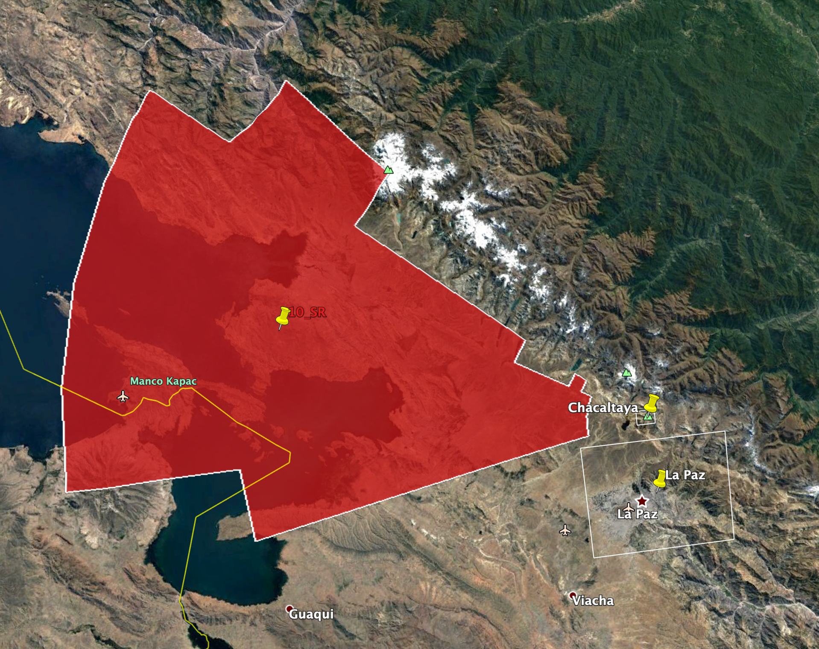

Slide 15
Proof of concept: Identification of the anthropogenic source of BC at CHC

Slide 16
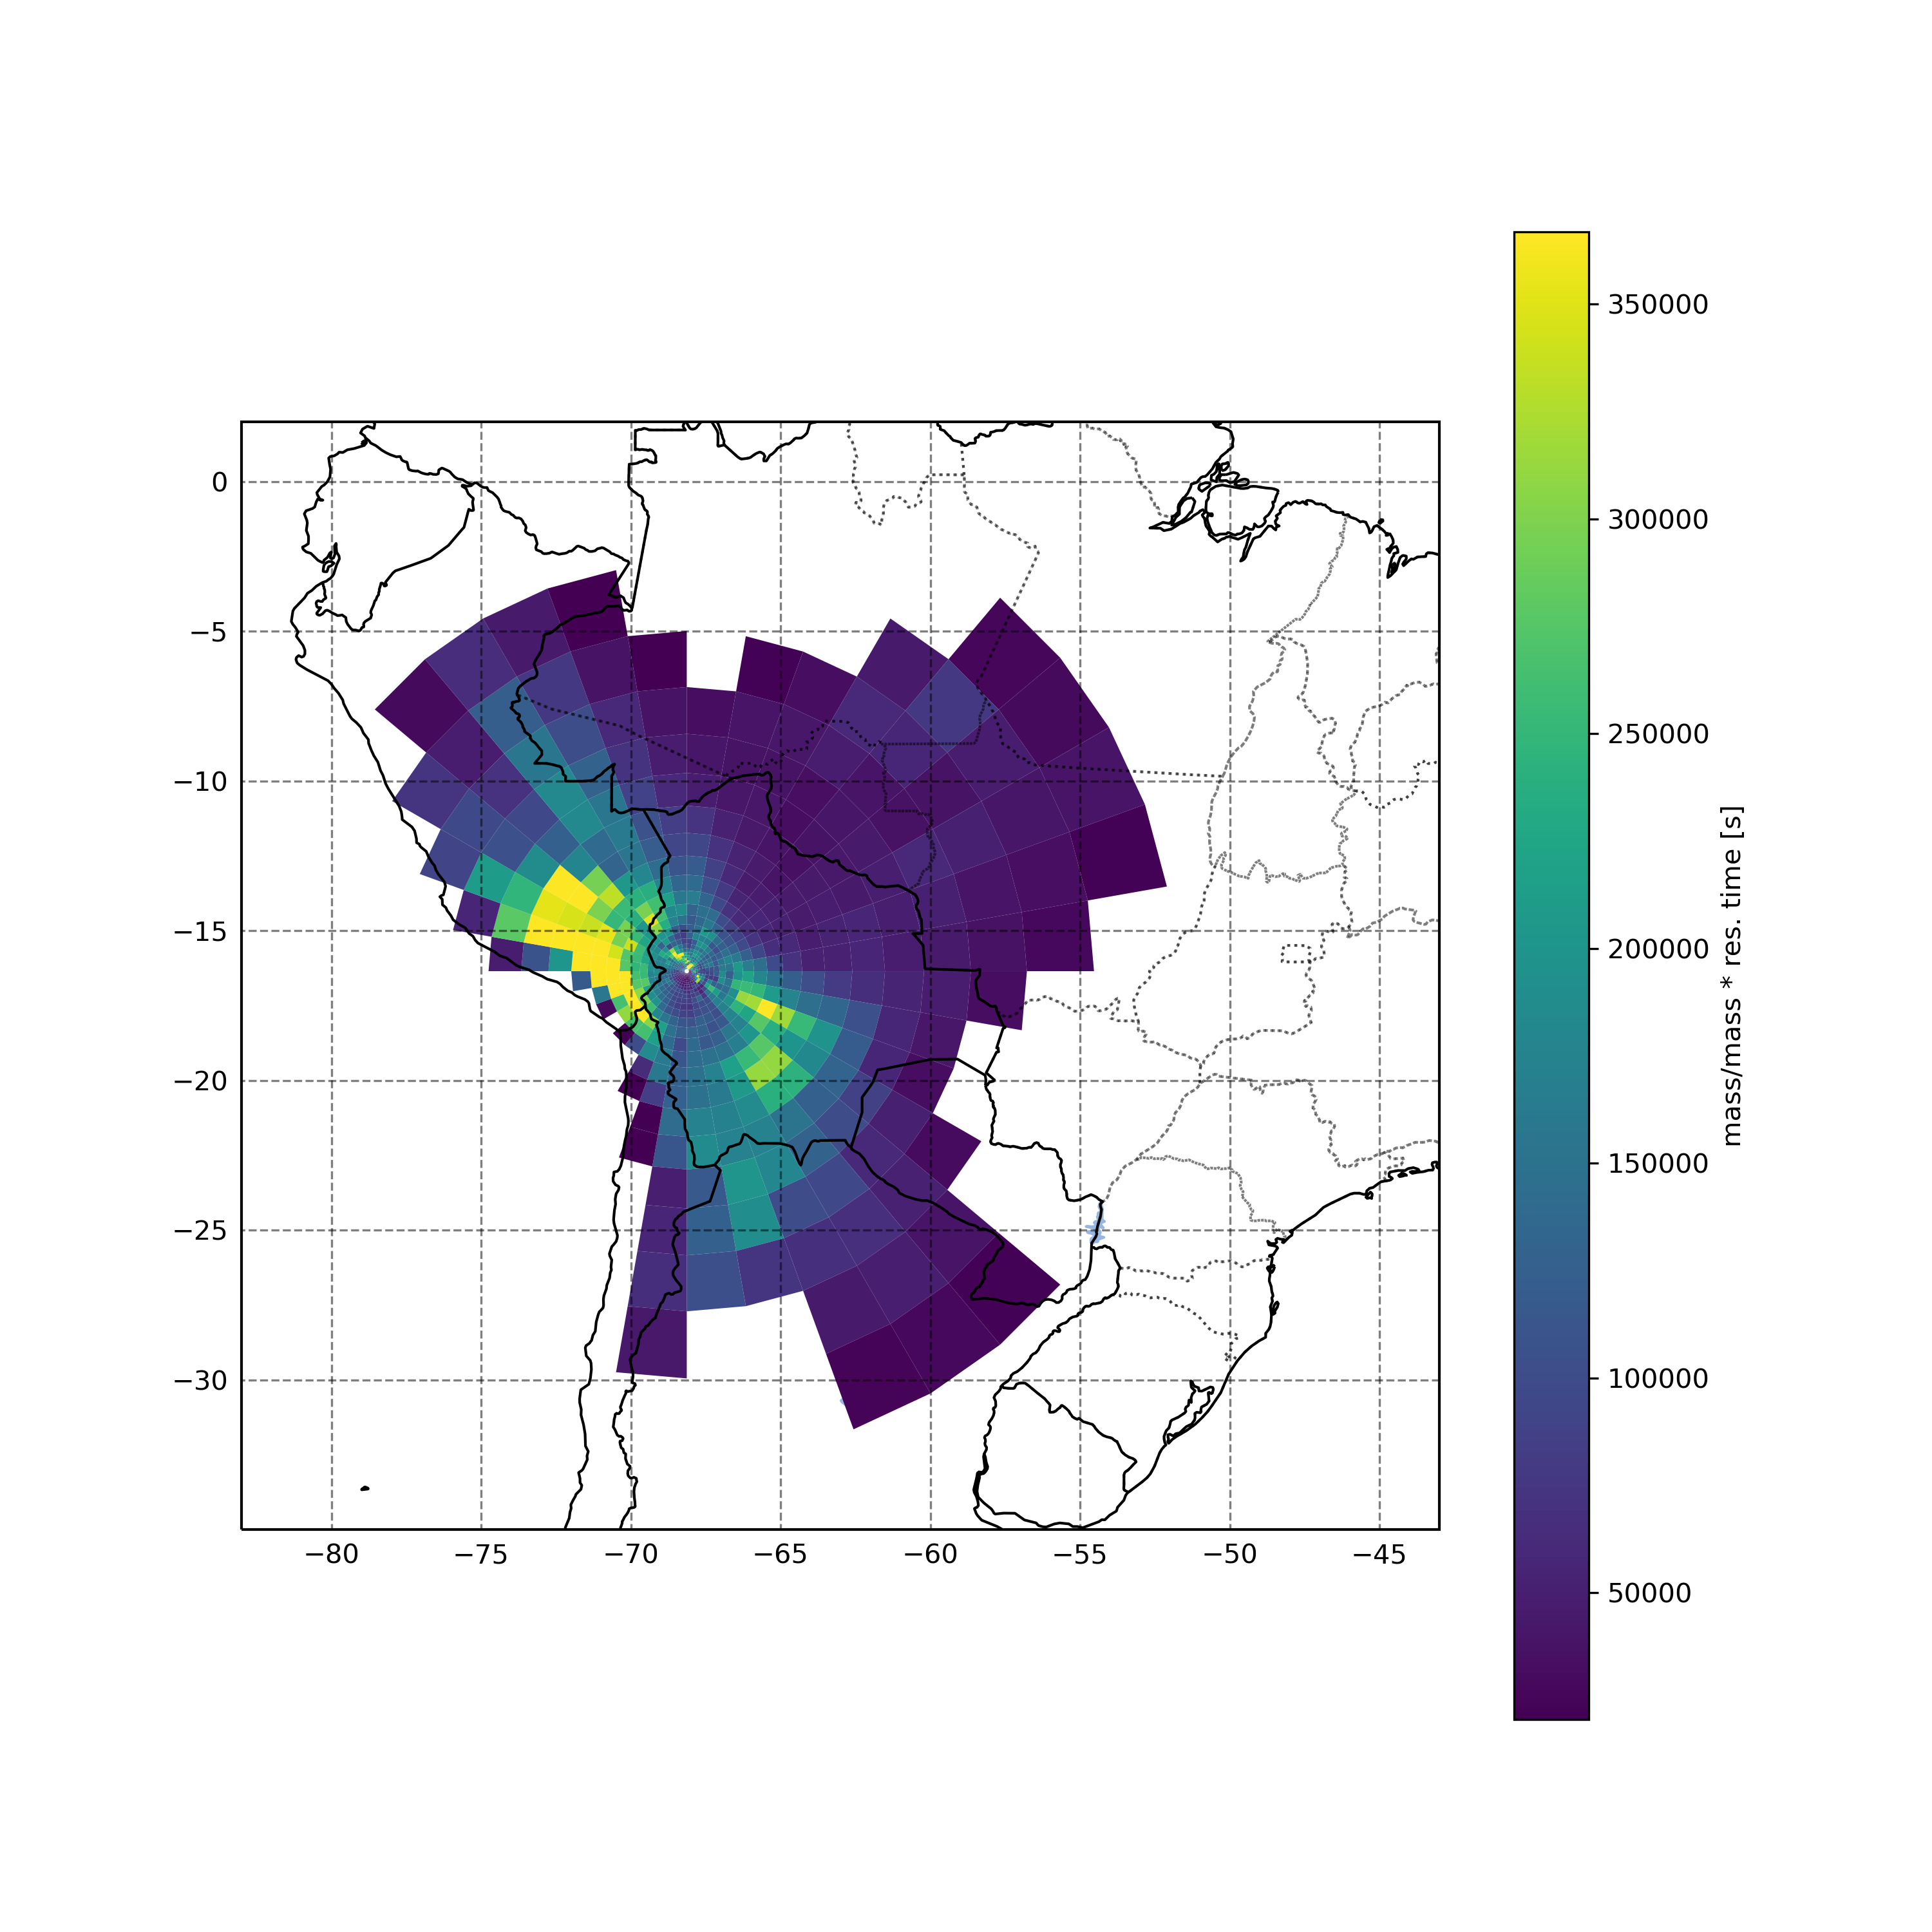
N. Particles * residence time (Arbitrary units)
v
Flexpart surface foot print (residence time * N. particles) aggregate over modeling period (2017.12.1~2018.6.1)
Compared to other regions, La Paz surface foot print does not significantly influence CHC
La Paz

Slide 17
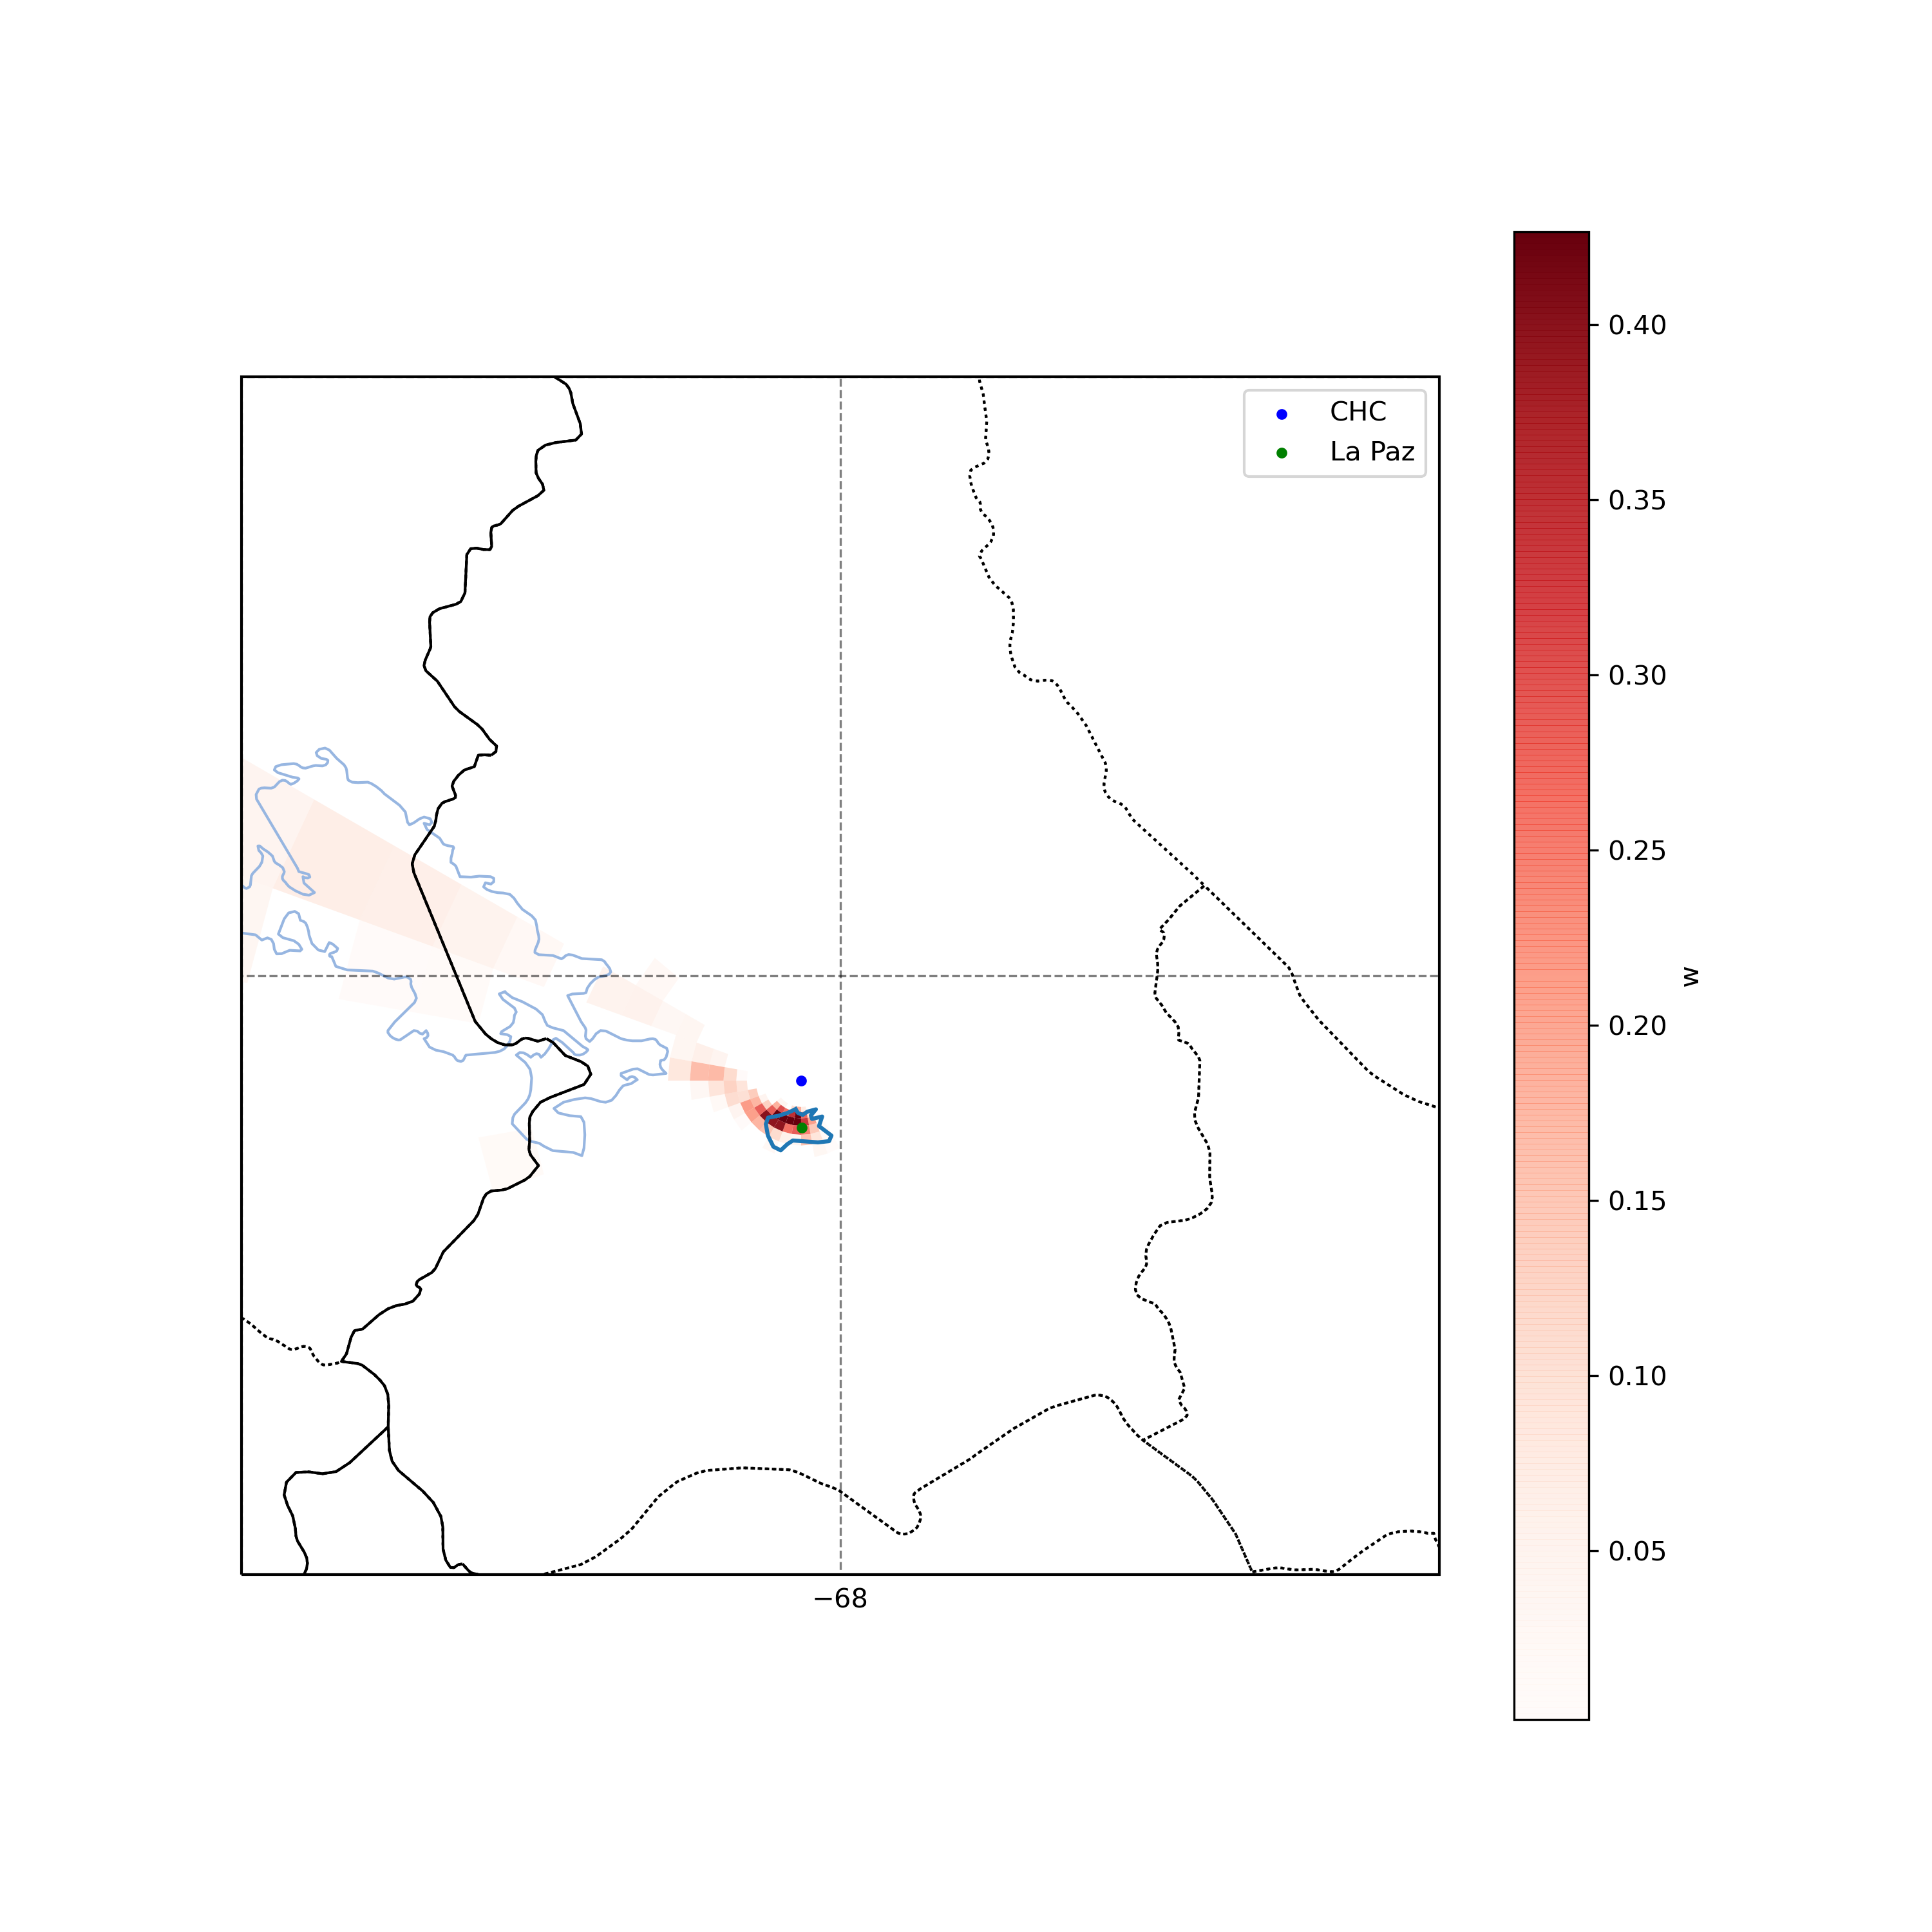
Elastic Net source attribution (w)
Zoomed in (from slide 1) Flexpart surface foot print (residence time * N. particles) aggregate over modeling period (2017.12.1~2018.6.1)
However, when doing an inverse modeling ElasticNet regression for sources of BC sampled at CHC,
La Paz polygon clearly stands out.

Slide 18
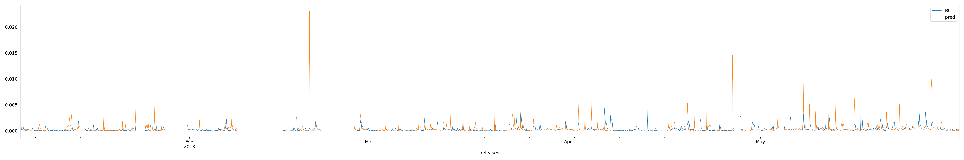
Timeseries sample BC vs Modeled (pred) BC from La Paz polygon using Elastic net source receptor regression

Slide 19
Proof of concept: Identification of the volcanic source of sulfate sampled at CHC

Slide 20
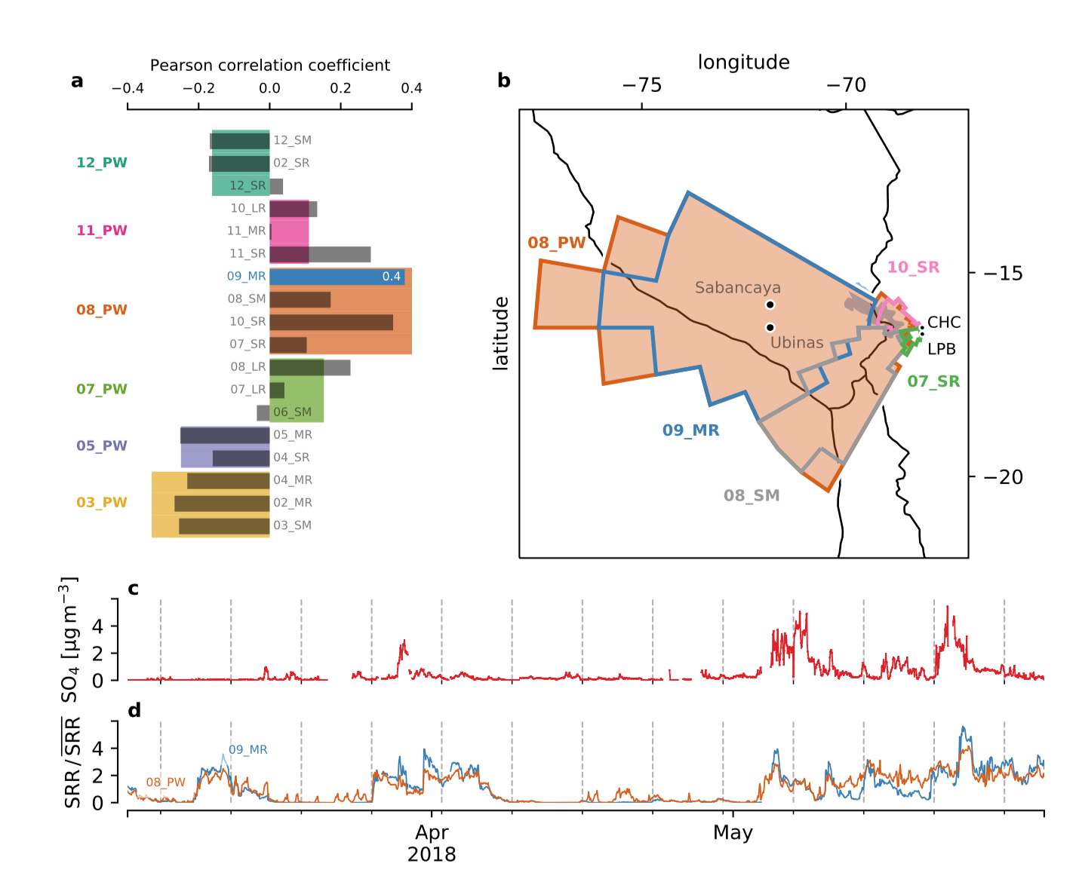

Slide 21
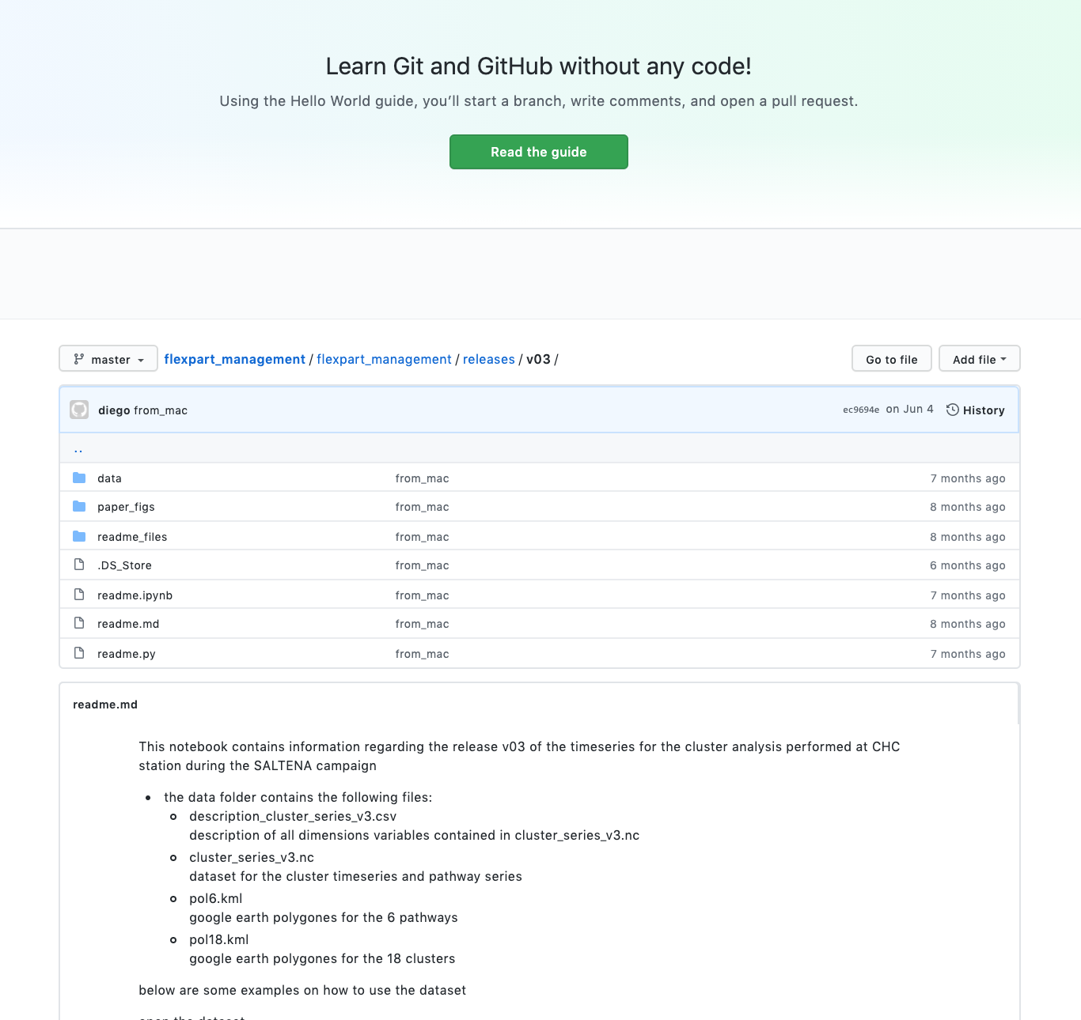
User friendly dataset
https://github.com/daliagachc/flexpart_management/tree/master/flexpart_management/releases/v03

Slide 22

Summary
We successfully identify the short/long range sources influencing CHC.
We successfully characterize the BL/FT influences at CHC.
User friendly dataset: github

